Slide 1


Piotr Palacz
08.03.2023

Slide 2

Outline
Executive Summary
Introduction
Methodology
Results
Conclusion
Appendix

Slide 3
Executive Summary
Summary of methodologies:
Data Collection – SpaceX API
Data Collection – Scraping
Data Wrangling
EDA with Data Visualization
EDA with SQL
Build an Interactive Map with Folium
Build a Dashboard with Plotly Dash
Predictive Analysis (Classification)
Summary of all results:
Exploratory data analysis results
Interactive analytics in screenshots
Predictive Analytics resault

Slide 4
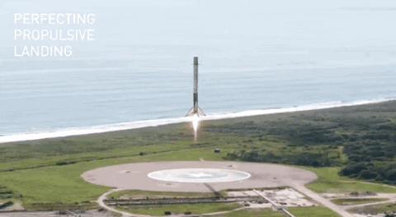
Introduction
In this project, we will predict if the Falcon 9 first stage will land successfully. SpaceX advertises Falcon 9 rocket launches on its website with a cost of 62 million dollars; other providers cost upward of 165 million dollars each, much of the savings is because SpaceX can reuse the first stage. Therefore if we can determine if the first stage will land, we can determine the cost of a launch. This information can be used if an alternate company wants to bid against SpaceX for a rocket launch.

Slide 5

Section 1

Slide 6
Methodology
Executive Summary
Data was extracted from the API issued by SpaceX and Wikipedia.
The extracted data were filtered to show only Falcon 9 launches, then missing payload mass data were replaced with an average value of payload mass
Exploratory data analysis (EDA) using visualization of correlation between parameters and SQL
Interactive visual analytics using Folium and Plotly Dash
Predictive analysis using classification models and attempting to select the best model

Slide 7
Data Collection
Data was collected from Space X Rest API and webscraping from Wikipedia
Space X API
Request and parse the SpaceX launch data using the GET reques
Decode the response content as a Json
Filter the dataframe to only include Falcon 9 launches
Missing payload mass data were replaced with an average value of payload mass
Wikipedia
Request the Falcon9 Launch Wiki page from its URL
Decode the response content with a BeautyfulSoup
Extract all column/variable names from the HTML table header
Create a data frame by parsing the launch HTML tables

Slide 8
Data Collection – SpaceX API
First we Request and parse the SpaceX launch data using the GET request function, then we decode the response content as a Json. At the end we filtered the dataframe to only include Falcon 9 launches and replaced missing payload mass data with an average value of payload mass
To check the notebook:
GitHub URL
Request and parse the SpaceX launch data using the GET request
Decode the response content as a Json
Filter the dataframe to only include Falcon 9 launches
Missing payload mass data were replaced with an average value of payload mass

Slide 9
Data Collection - Scraping
First we request the Falocon 9 data from Wikipedia page from its URL, then we decode the response content using BeautyfulSoup library. At the end we extract all column/variable names from the HTML table header and create a data frame.
To check the notebook:
GitHub URL
Request the Falcon9 Launch Wiki page from its URL
Decode the response content with a BeautyfulSoup
Extract all column/variable names from the HTML table header
Create a data frame by parsing the launch HTML tables

Slide 10
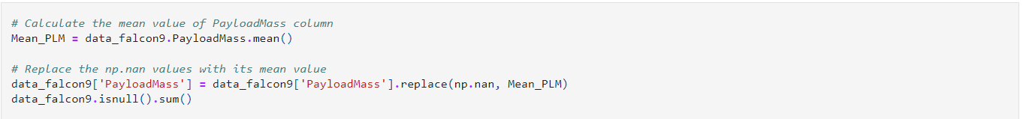
Data Wrangling
We filtered the dataframe to only include Falcon 9 launches and replaced missing payload mass data with an average value of payload mass using the NumPY library.
To check the notebook:
GitHub URL

Slide 11
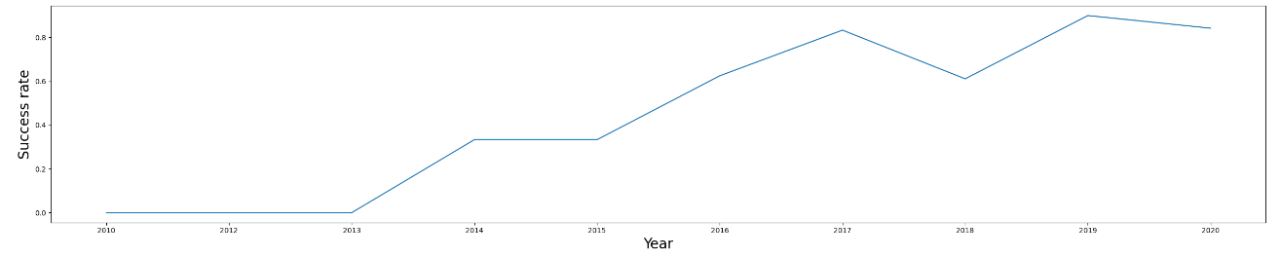
EDA with Data Visualization
Using dot plots, it is visualised how the relationships between specific data influence launch success. In addition, thanks to the visualisation, we can easily see that the success of the launch is increasing year on year.
To check the notebook:
GitHub URL

Slide 12
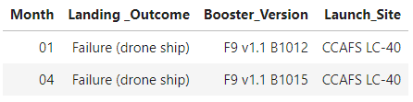
EDA with SQL
The total payload mass carried by boosters launched by NASA (CRS) was 45596 kg
Average payload mass carried by booster version F9 v1.1 was 2928.4 kg
First succesful landing outcome in ground pad was achieved in 01-05-2017
F9 FT B1022, F9 FT B1026, F9 FT B1021.2, F9 FT B1031.2 was boosters which have success in drone ship and have payload mass greater than 4000 but less than 6000
It was 100 successful mission outcomes and only 1 failure
in year 2015 were two lunches:
To check the notebook:
GitHub URL

Slide 13

Build an Interactive Map with Folium
On map was marked all launch sites, the success/failed launches for each site and was calculated the distances between a launch site to its proximities. We use folium Circle to add a highlighted circle area with a text label on a specific coordinate. Next, we explore and analyze the proximities of launch sites. We mark down a point on the closest coastline using MousePosition and calculate the distance between the coastline point and the launch site, then draw a PolyLine between a launch site to the selected coastline point.
To check the notebook:
GitHub URL
Notes:
Draw a PolyLine between a launch site to the selected coastline point

Slide 14
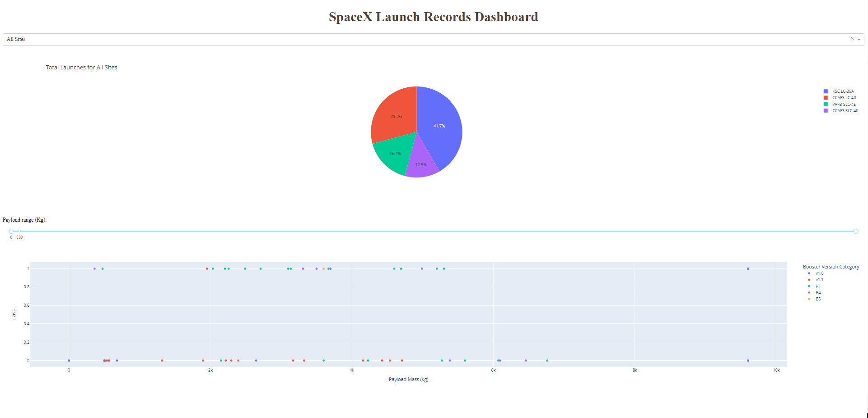
Build a Dashboard with Plotly Dash
We bulit a Dashbord including menu for selecting lunch site, pie charts displaying success rate, scatter chart displaying lunch site, payload mass and success/failure. This dashbord was bulit for find lunch site with highest success rate and payload range with highest lunch success rate
To check the dashboard:
GitHub URL

Slide 15
Predictive Analysis (Classification)
Using the standardscaler library, the variables used in the analysis were standardised. the dataset was split into test data and training data. 4 machine learning models were then created: logistic regression, support vector machine, decision tree classifier and k nearest neighbours. For each model, tuning was carried out using GridSearchCV to find the best parameters. For each model, the accuracy and For each model, the accuracy was calculated and the best model was selected on the basis of this accuracy.
To check the notebook:
GitHub URL
Standardise data
Split into test data and training data
Bulid model
Using GridSearchCV to find the best parameters
Calculate accuracy

Slide 16
Results
Exploratory data analysis results
Interactive analytics in screenshots
Predictive Analytics resault

Slide 17

Section 2

Slide 18
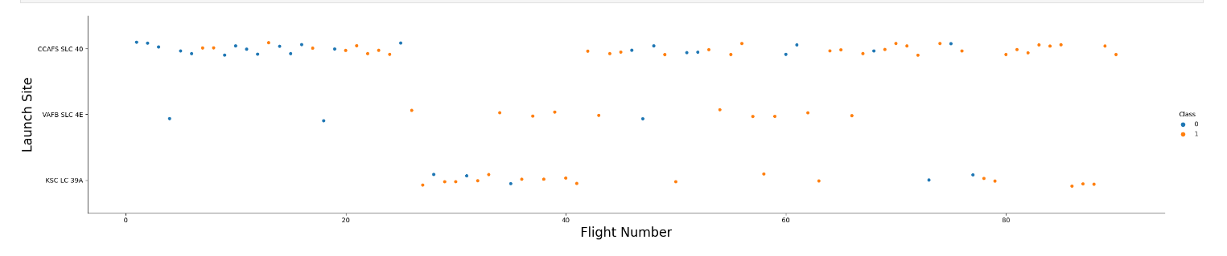
Flight Number vs. Launch Site
In the graph, we can see that the higher the flight number, the greater the probability of success. This means that the rockets got better and better over time.

Slide 19
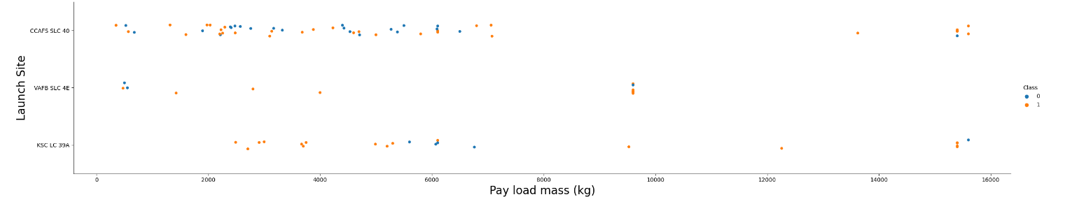
Payload vs. Launch Site
In the graph, we can see that the greather pay load mass, the greater the probability of success.

Slide 20
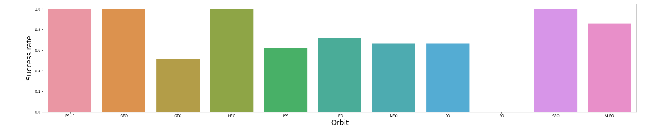
Success Rate vs. Orbit Type
We can see that orbits ES-L1, GEO, HEO, SSO have 100% success rate. Also orbit type SO have 100% failure.

Slide 21
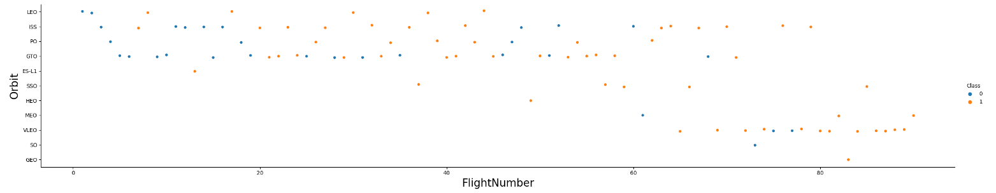
Flight Number vs. Orbit Type
In the graph, we can see that GTO orbits are relatively rarely successful, in contrast to VLEO orbits where success is frequent.

Slide 22
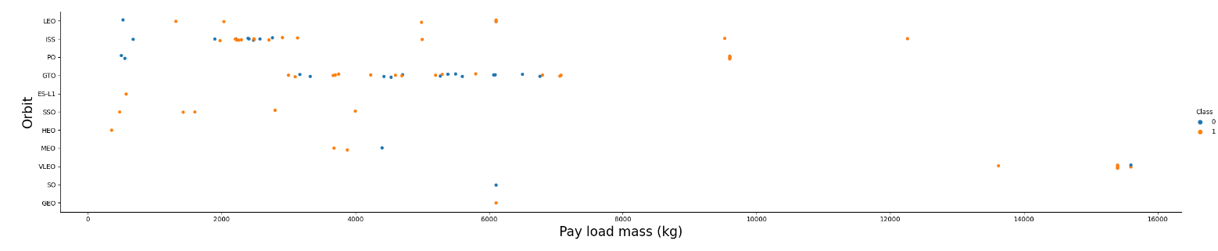
Payload vs. Orbit Type
On the plot we can see that heavy paylooads for PO and LEO orbits increase the success rate.

Slide 23
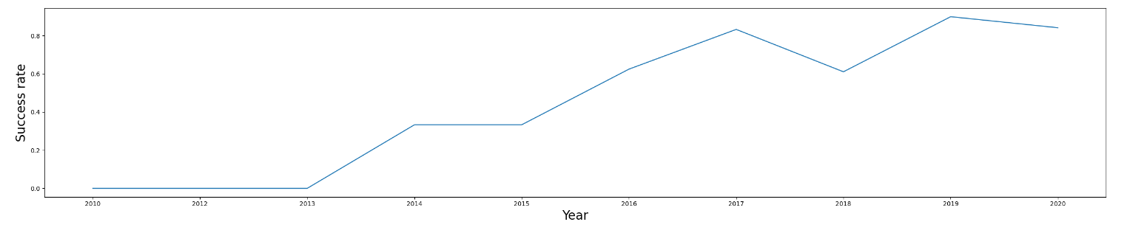
Launch Success Yearly Trend
Thanks to the visualisation, we can easily see that the success of the launch is increasing year on year.

Slide 24
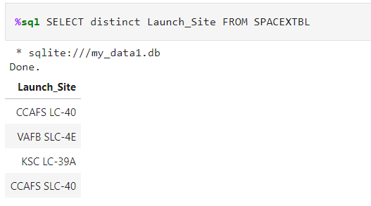
All Launch Site Names
There are 4 distinct lunch site names

Slide 25
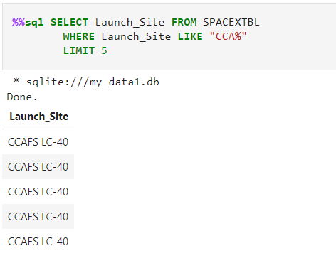
Launch Site Names Begin with 'CCA'
5 records where launch sites name starts with `CCA`

Slide 26
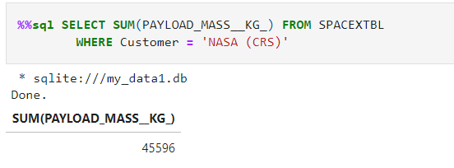
Total Payload Mass
The total payload carried by boosters from NASA

Slide 27
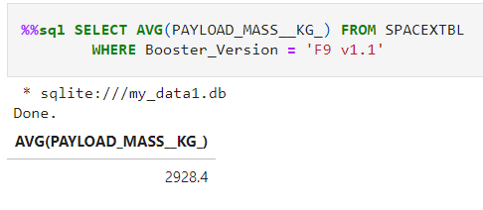
Average Payload Mass by F9 v1.1
The average payload mass carried by booster version F9 v1.1

Slide 28
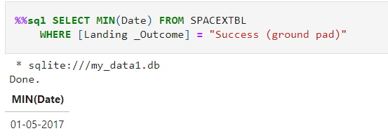
First Successful Ground Landing Date
The date of the first successful landing outcome on ground pad

Slide 29
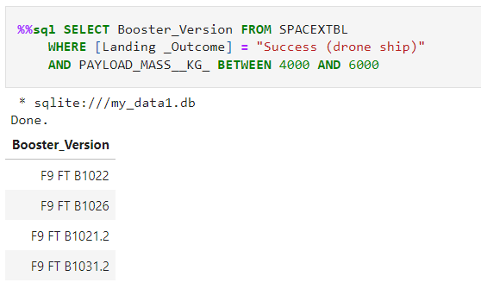
Successful Drone Ship Landing with Payload between 4000 and 6000
The names of boosters which have successfully landed on drone ship and had payload mass greater than 4000 but less than 6000

Slide 30
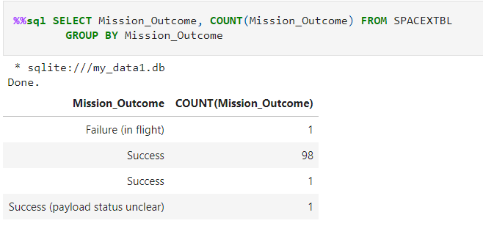
Total Number of Successful and Failure Mission Outcomes
The total number of successful and failure mission outcomes

Slide 31
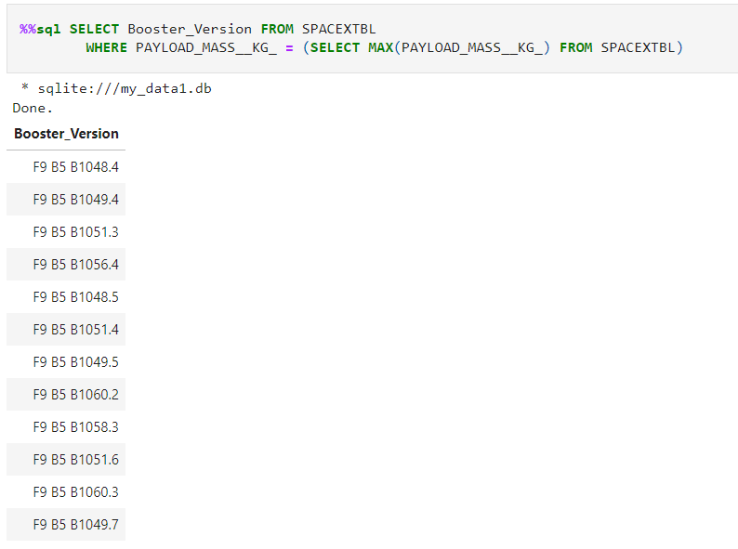
Boosters Carried Maximum Payload
The names of the booster which have carried the maximum payload mass

Slide 32
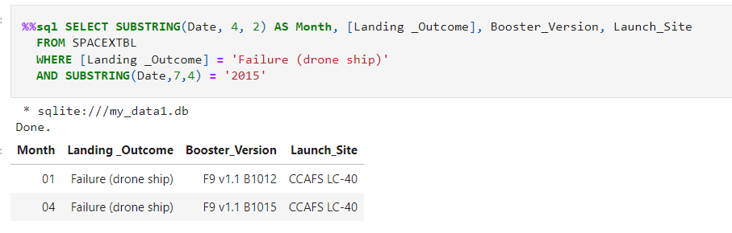
2015 Launch Records
The failed landing_outcomes in drone ship, their booster versions, and launch site names for in year 2015

Slide 33
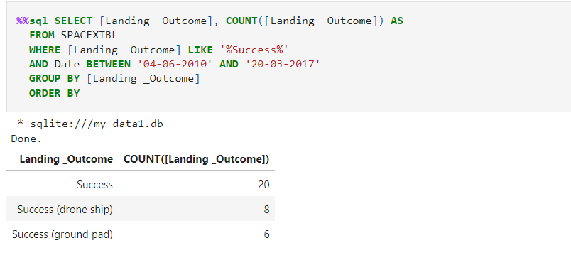
Rank Landing Outcomes Between 2010-06-04 and 2017-03-20
Rank the count of landing outcomes (such as Failure (drone ship) or Success (ground pad)) between the date 2010-06-04 and 2017-03-20, in descending order

Slide 34

Section 3

Slide 35
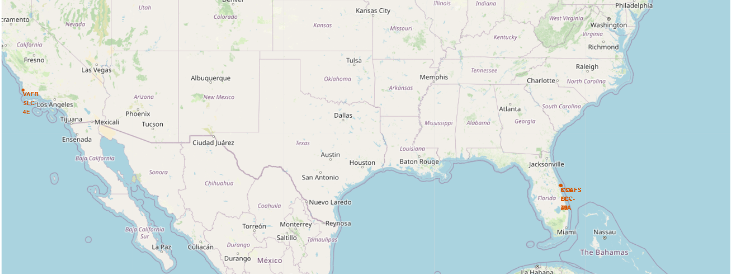
Lunch sites locations
Replace <Folium map screenshot 1> title with an appropriate title
Explore the generated folium map and make a proper screenshot to include all launch sites’ location markers on a global map
Explain the important elements and findings on the screenshot

Slide 36
Lunch sites locations- colored success lunches

Slide 37
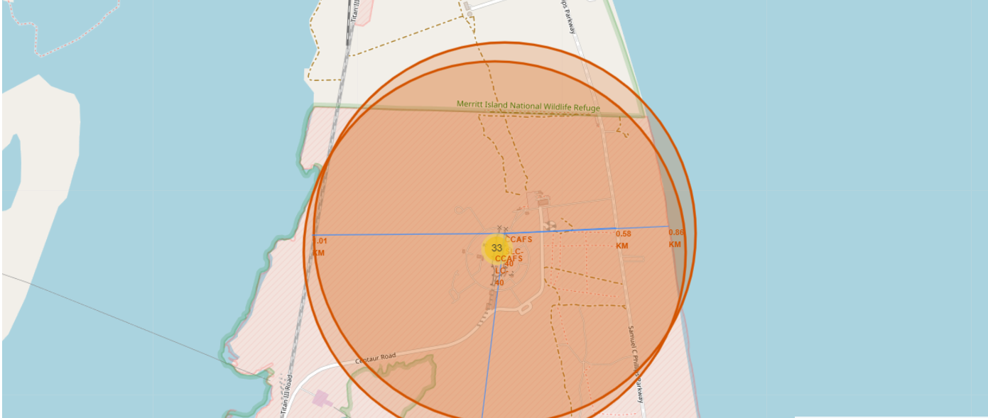
Lunch sites locations- distance

Slide 38

Section 4

Slide 39
Dashboard- All sites

Slide 40
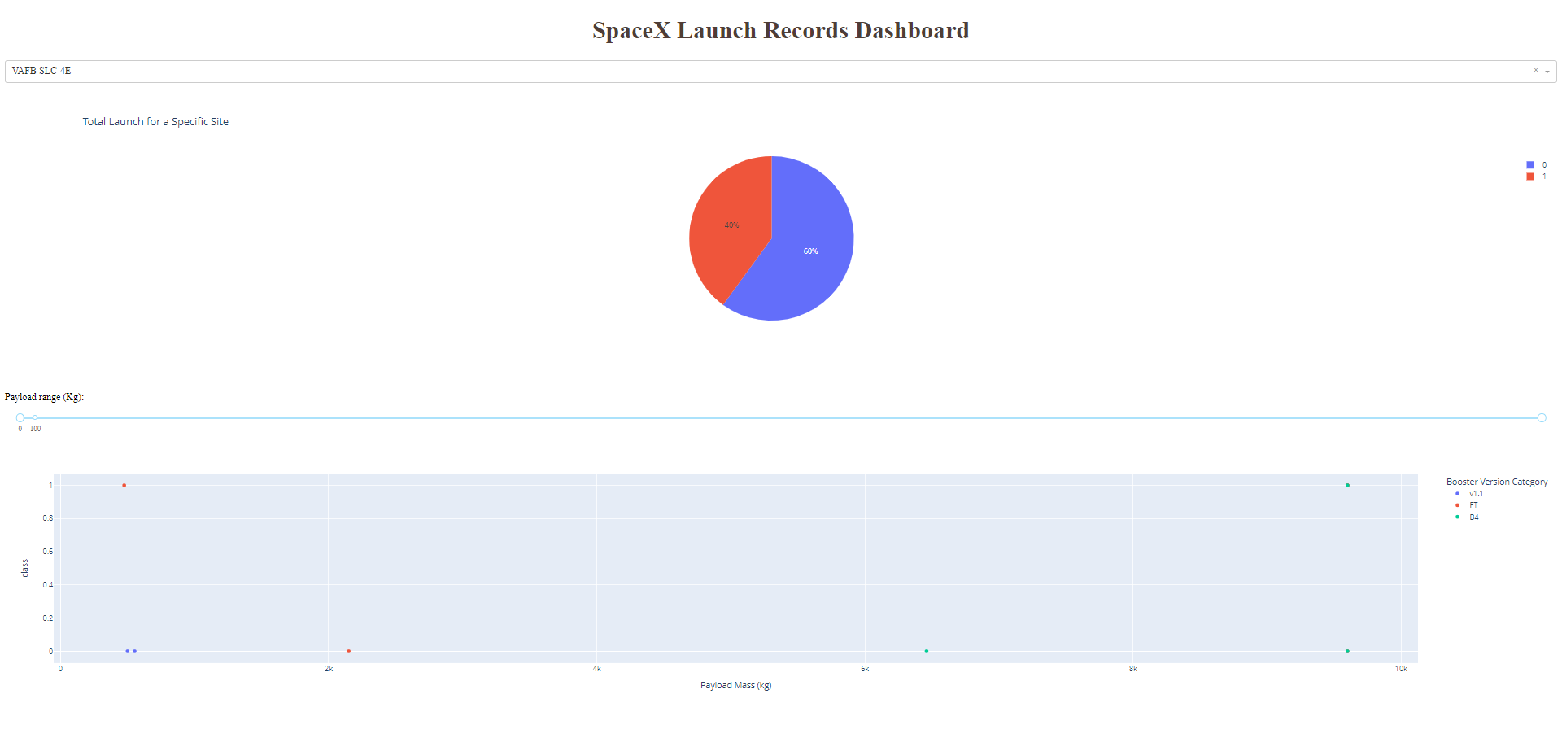
Dashboard- VAFB SLC- 4E

Slide 41
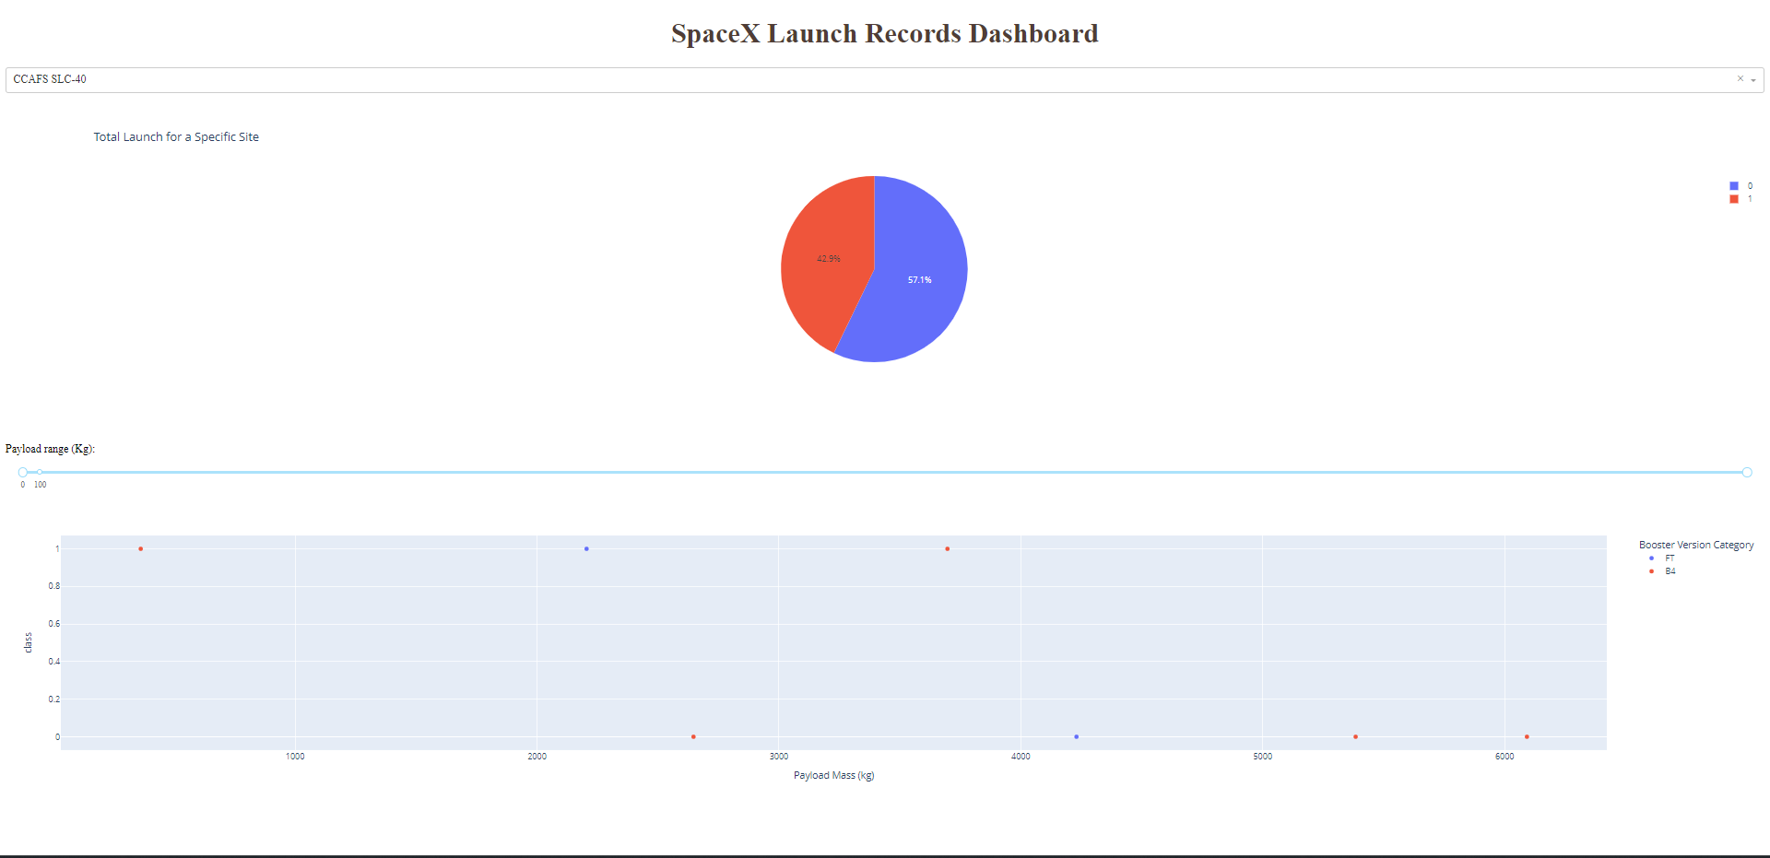
Dashboard- CCAFS SLC-40

Slide 42

Section 5

Slide 43
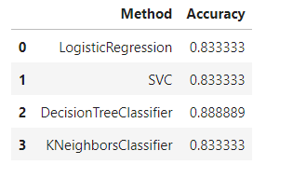
Classification Accuracy
The best accuracy has Decision Tree model with 0.89 accuracy. All other models have the same accuracy - 0.83.

Slide 44
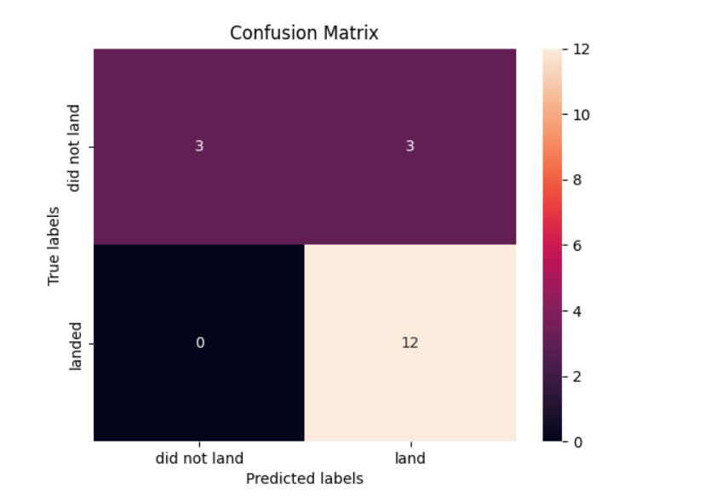
Confusion Matrix
The main problem is 3 false positives

Slide 45
Conclusions
Lunch success rate increase year by year
Orbits GEO, HEO, VLEO has the most success rate
KSC LC-39A has the most succesful lunches
The decision tree performs the best for this task

Slide 46
Appendix
Pyhon code for dashboard CLICK

Slide 47


